Slide 1



ArcGIS API for JavaScript: 2D Visualization
2020 ESRI USER CONFERENCE
Kristian Ekenes & Jeremy Bartley

Slide 2

Discover how to visualize geodata in meaningful ways using the ArcGIS API for JavaScript
Notes:
Motivation – why are they here

Slide 3
One visualization cannot tell the whole story
Notes:
Motivation – why are they here

Slide 4
API Overview
Renderers, Symbols, etc.

Slide 5
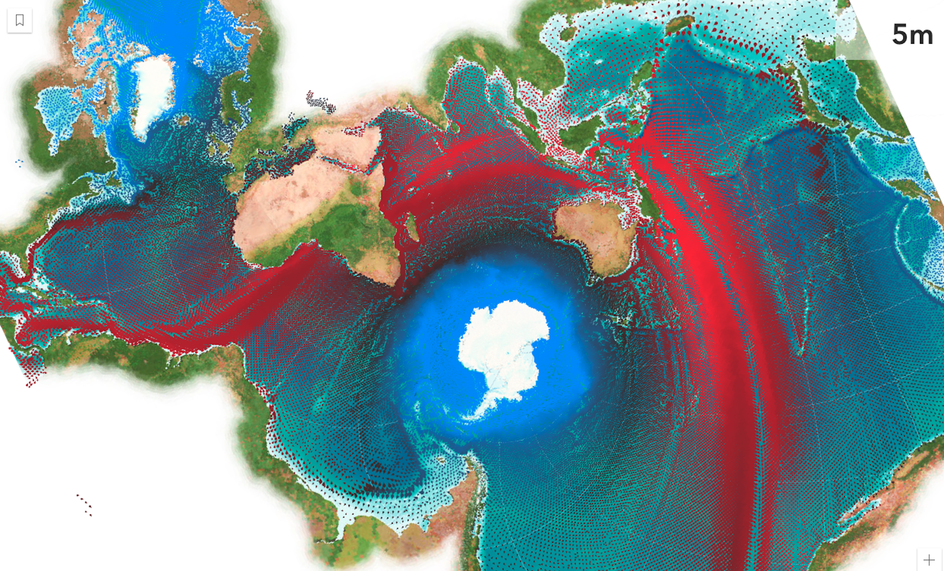
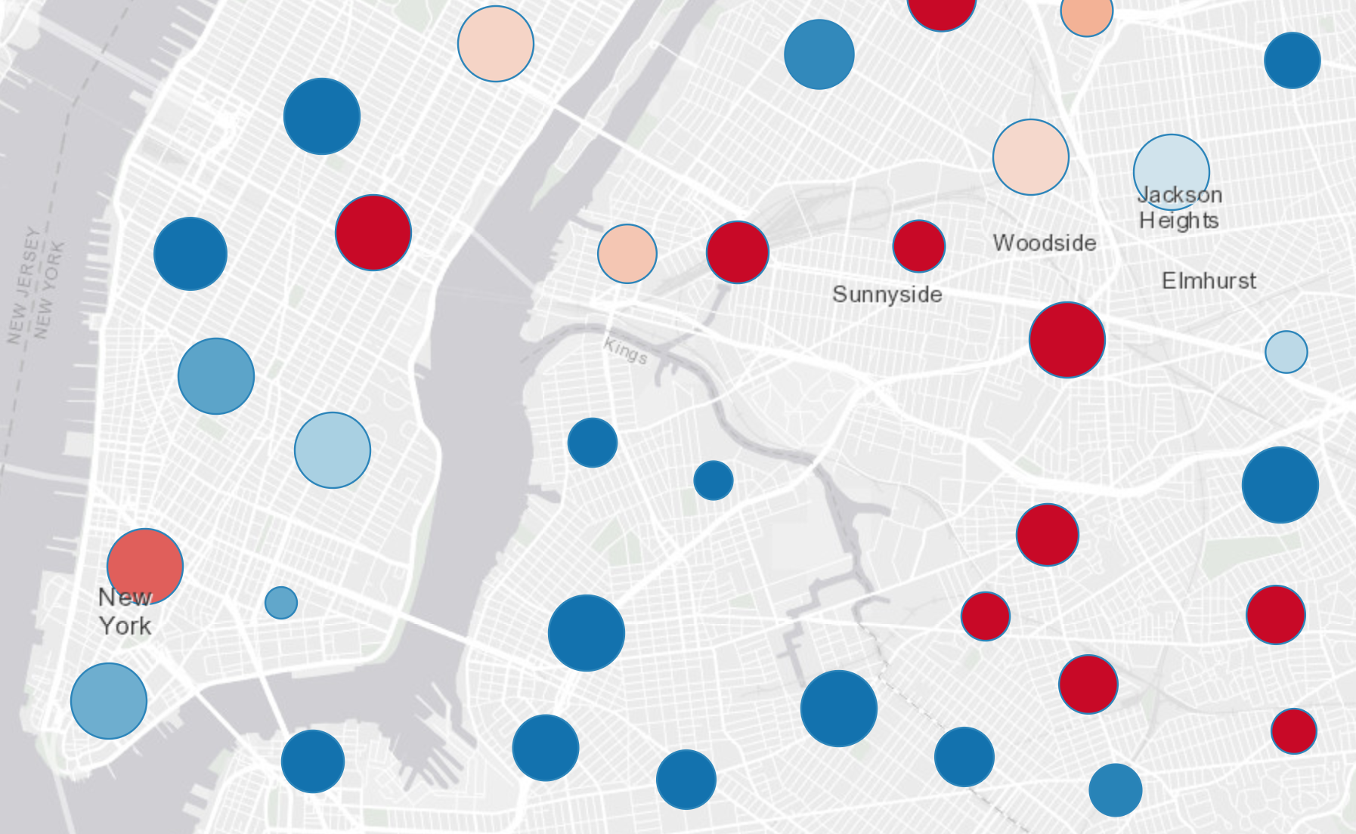
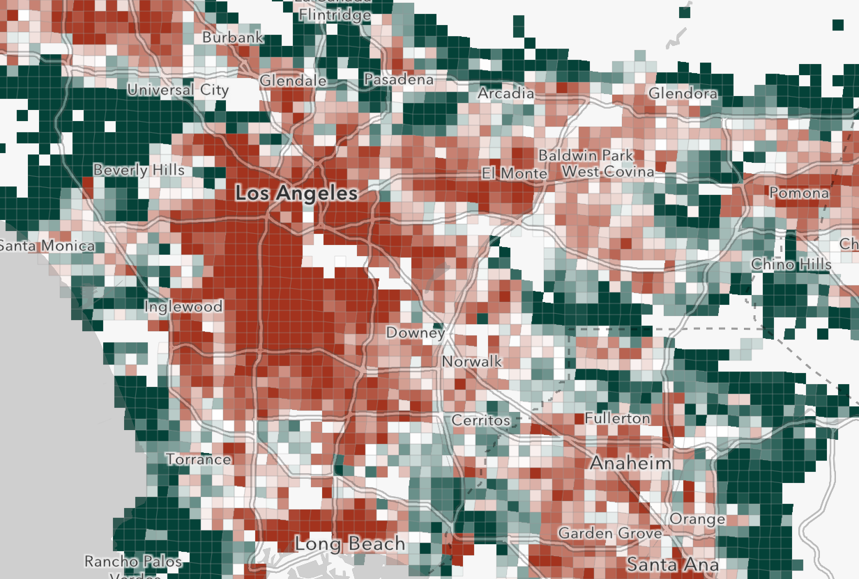
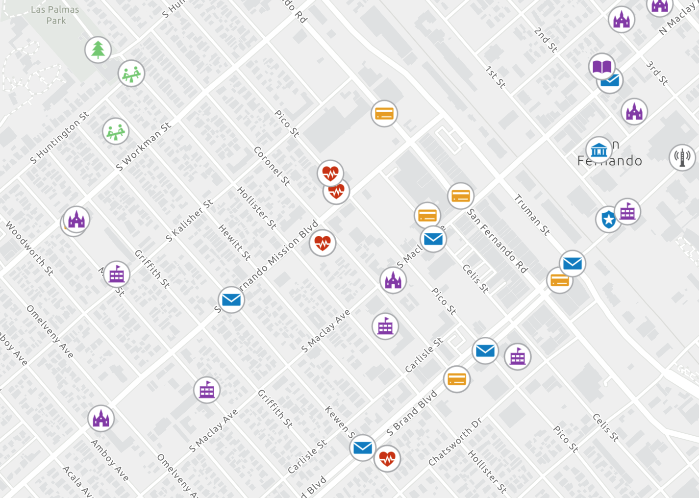
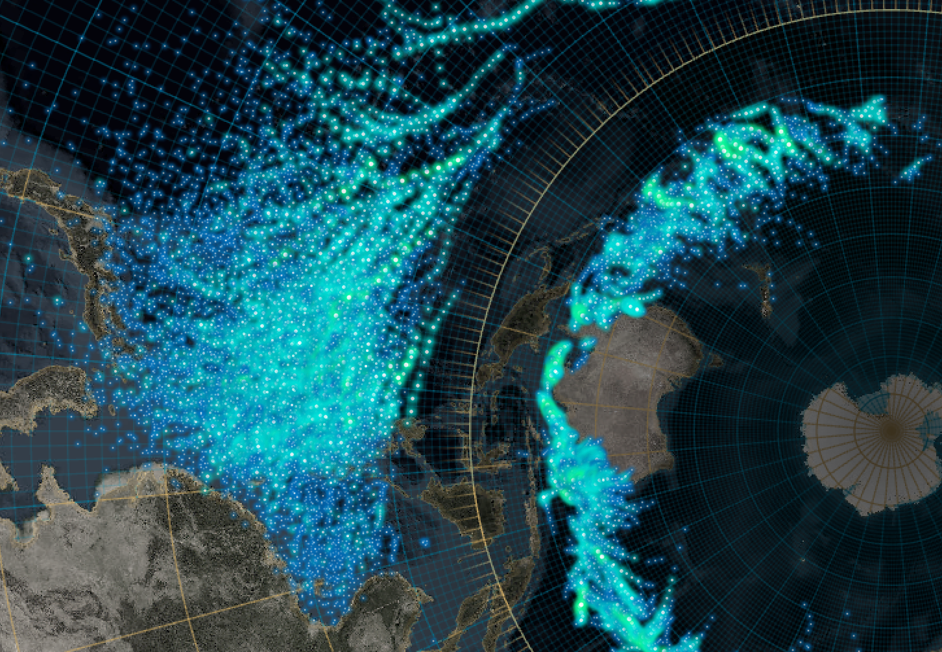

What can we visualize?
Where?
What?
How much?
When?
Multivariate

Slide 6
Symbols

Slide 7
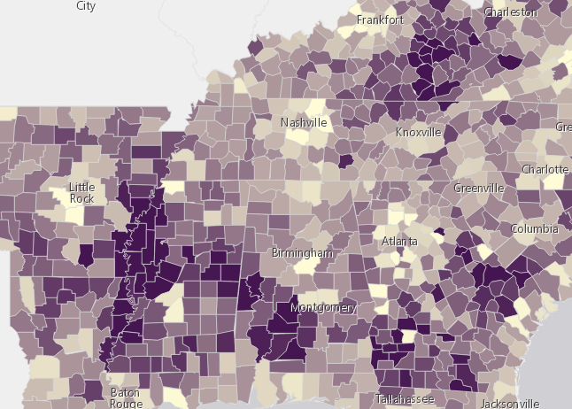
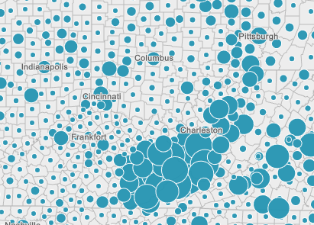
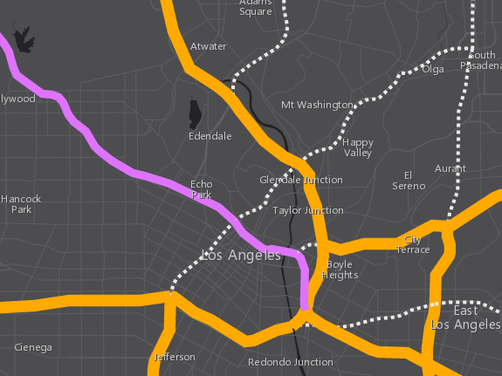
Symbols
SimpleFillSymbol
PictureFillSymbol
SimpleMarkerSymbol
PictureMarkerSymbol
WebStyleSymbol
CIMSymbol
SimpleLineSymbol
based on geometry type
Polygons
Points
Polylines

Slide 8
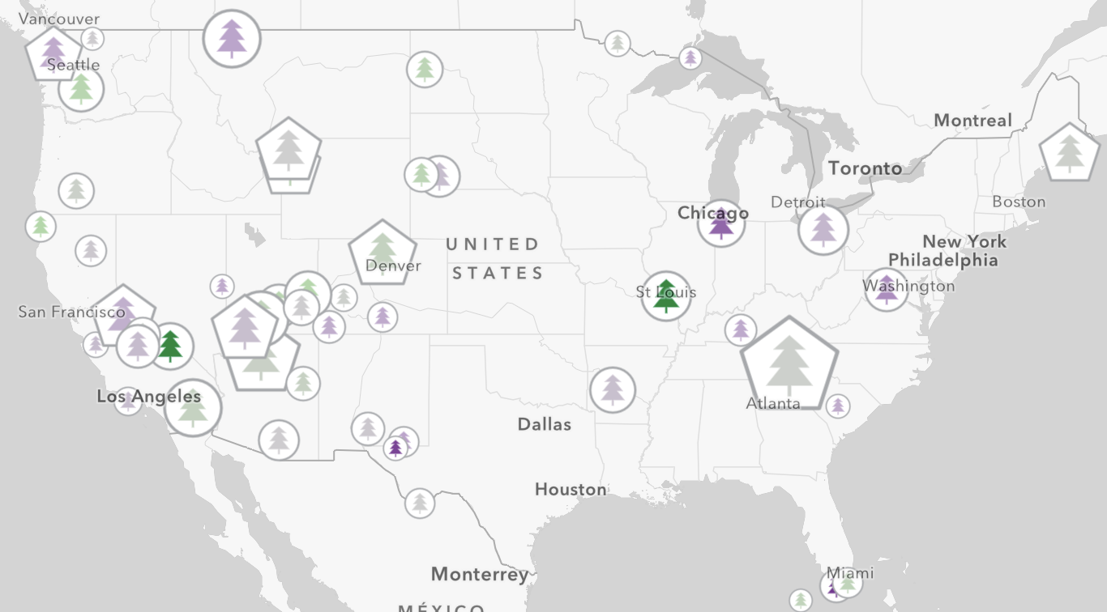
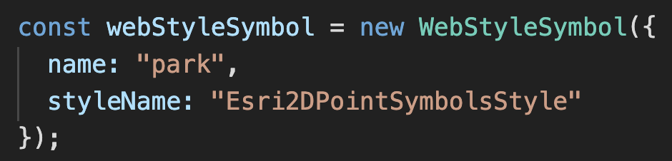
Web Style Symbols
2d styles
Cartographic Information Model (CIM)
Vectors
Scalable
Multi-layer
Overrides
Notes:
Show the playground here

Slide 9
Renderers

Slide 10
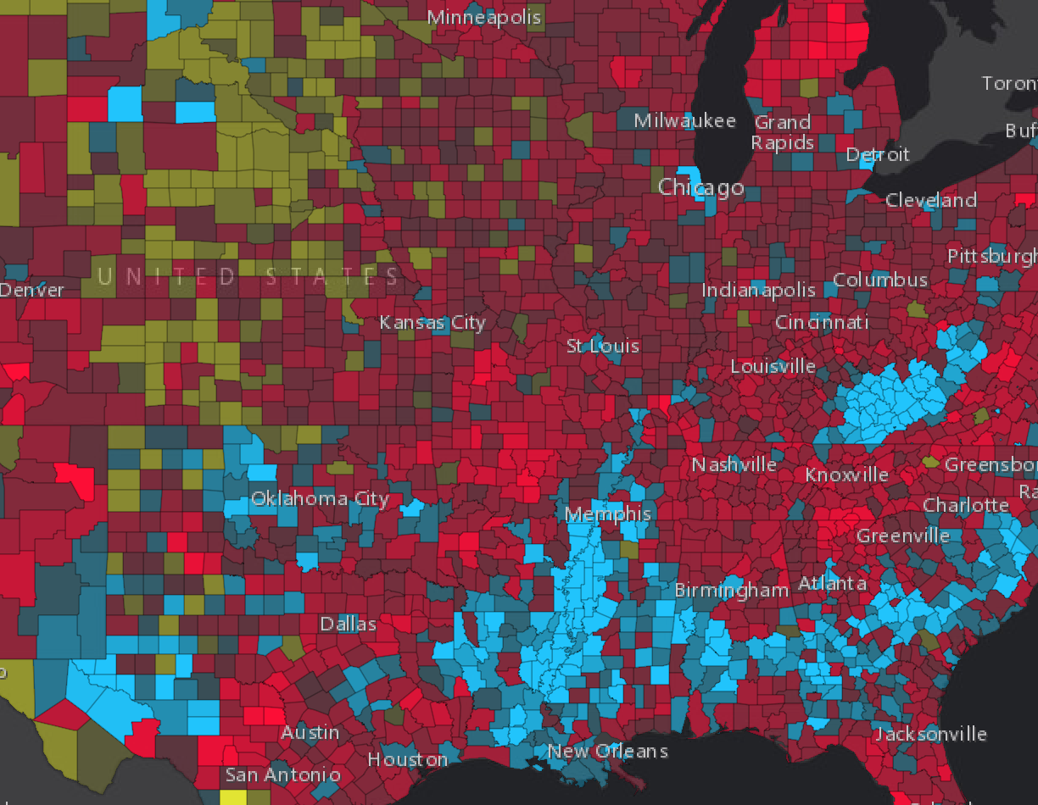
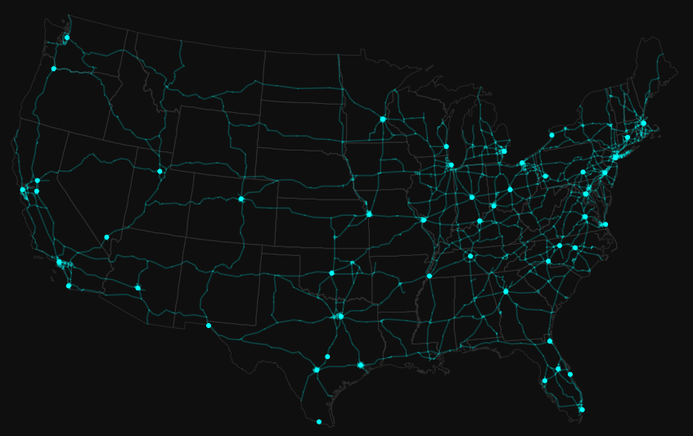
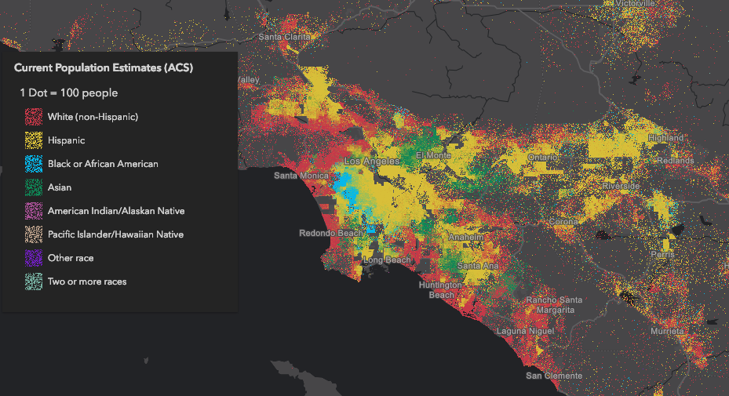
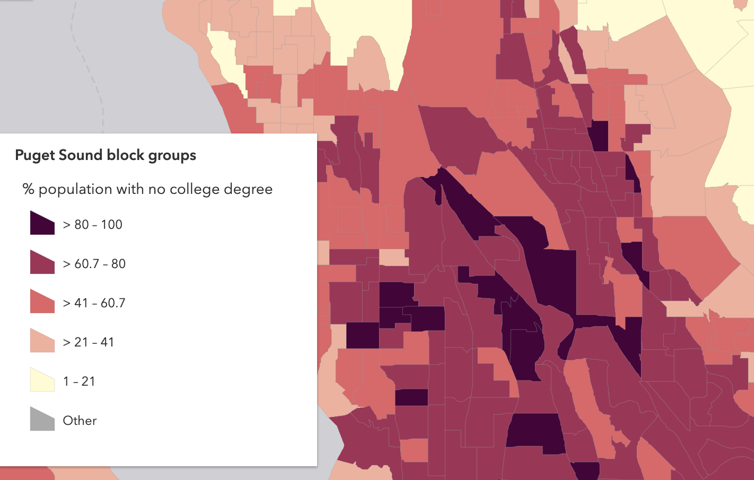
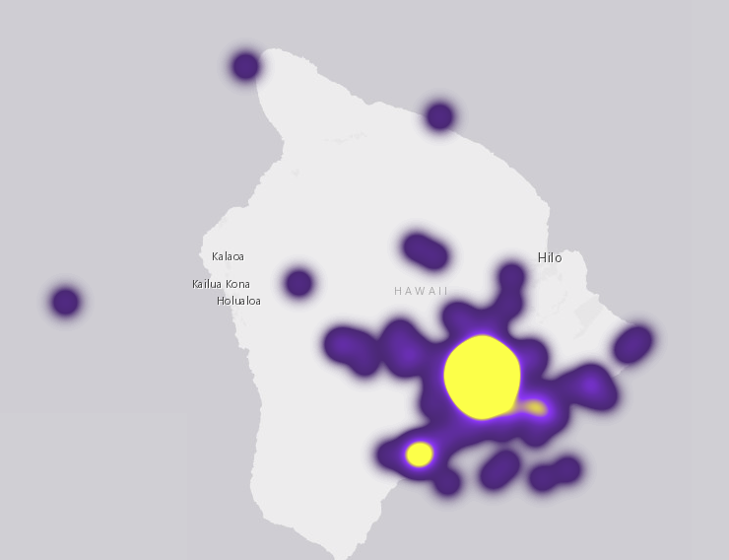
Renderers
UniqueValueRenderer
SimpleRenderer
DotDensityRenderer
ClassBreaksRenderer
HeatmapRenderer

Slide 11
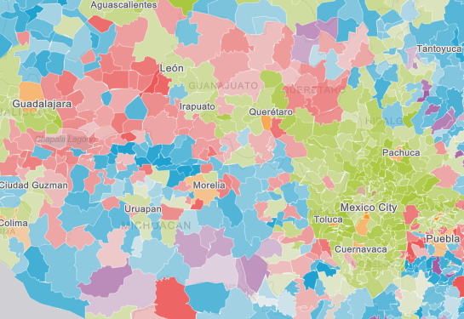
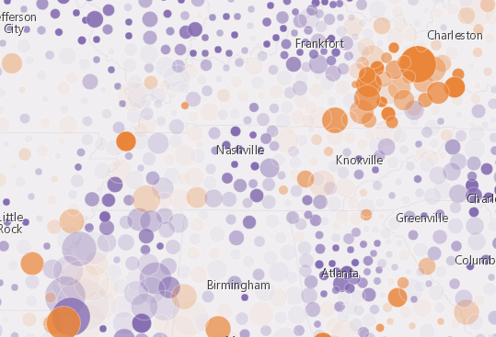
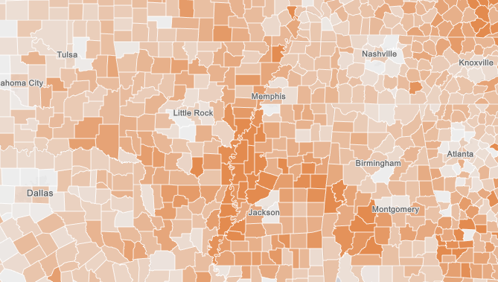
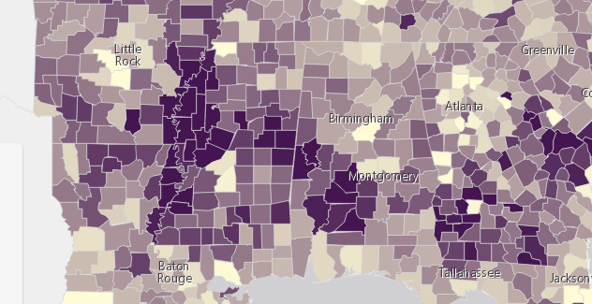
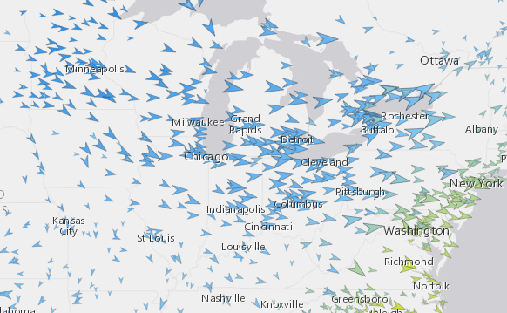
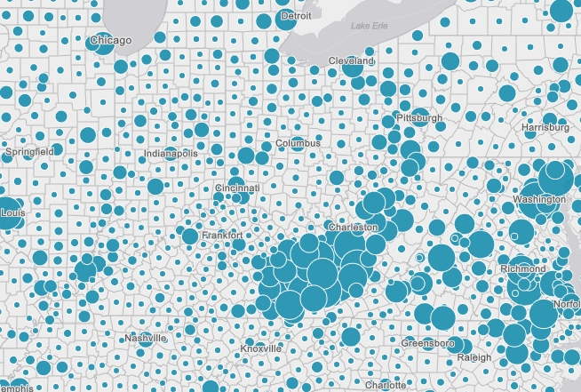
Renderers
Visual Variables
A property of the renderer
For numeric data-driven continuous visualizations
Color
Size
Opacity
Rotation

Slide 12
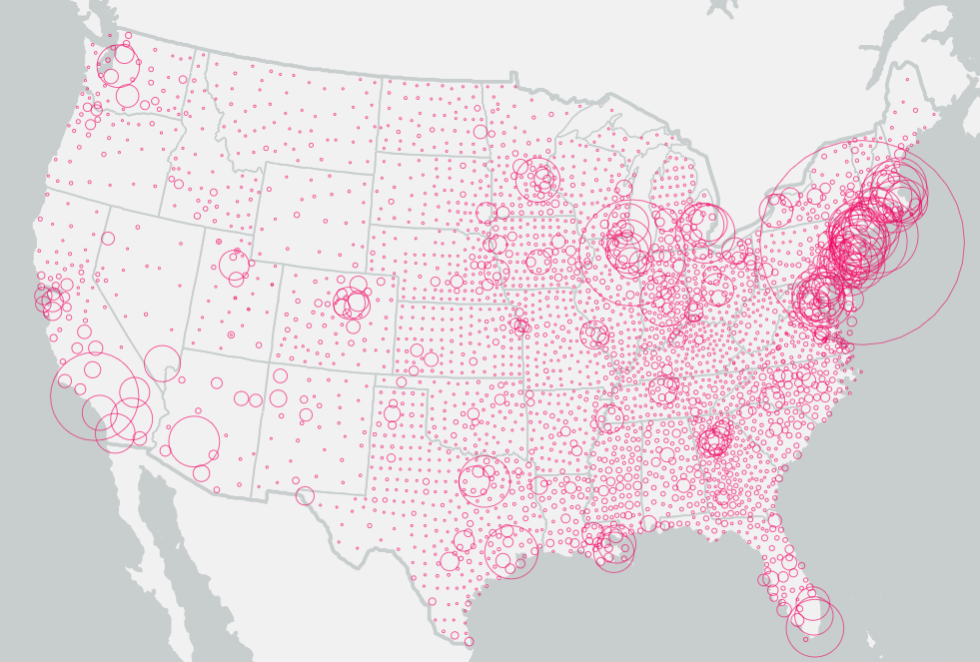
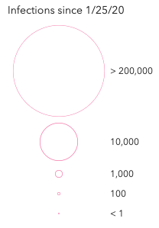
Data driven visualization
layer.renderer = new SimpleRenderer({
symbol: new SimpleMarkerSymbol({
style: "none",
outline: new SimpleLineSymbol({
color: new Color("rgba(227, 0, 106)"),
width: 0.5
})
}),
visualVariables: [
new SizeVariable({
field: "INFECTIONS_6_1_2020",
stops: [
{ value: 1, size: "2px" },
{ value: 100, size: "4px" },
{ value: 1000, size: "10px" },
{ value: 10000, size: "50px" },
{ value: 200000, size: "200px" }
]
})
]
});
Symbol
Data
Size
driven
by data
Field value

Slide 13
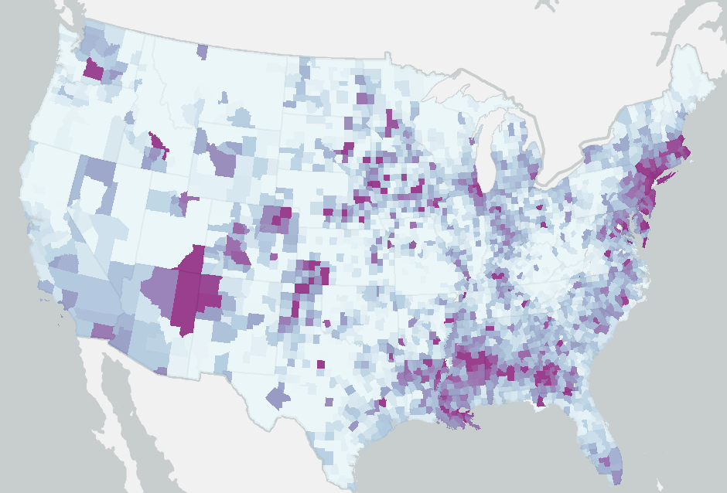
Data driven visualization
layer.renderer = new SimpleRenderer({
symbol: new SimpleFillSymbol({
outline: new SimpleLineSymbol({
color: "rgba(128,128,128,0.4)",
width: 0
})
}),
visualVariables: [
new ColorVariable({
valueExpression: `
var currentDayValue = $feature["DAYSTRING_05_31_2020"];
var currentDaySplit = Split(currentDayValue, "|");
var infections = Number(currentDaySplit[0]);
var deaths = Number(currentDaySplit[1]);
var population = $feature.Population_1;
return (infections / population ) * 100000;
`,
valueExpressionTitle: `Infections per 100k`,
stops: [
{ value: 50, color: "#edf8fb" },
{ value: 200, color: "#b3cde3" },
{ value: 500, color: "#8c96c6" },
{ value: 1000, color: "#8856a7" },
{ value: 1500, color: "#810f7c" }
]
})
]
});
Symbol
Data
Color
driven
by data
Arcade
expression

Slide 14
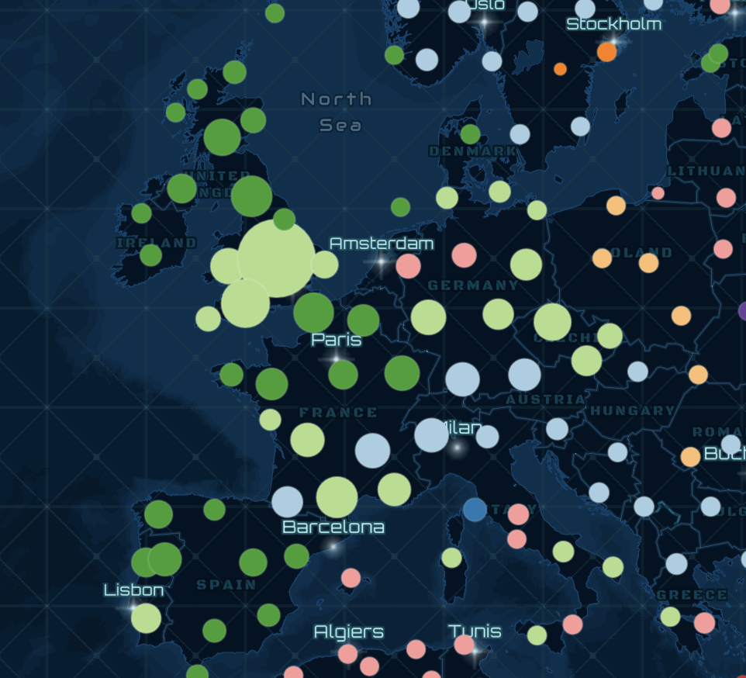
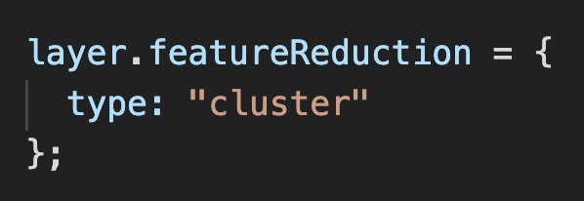
Clustering
FeatureReductionCluster

Slide 15
Symbol Size by Scale
ArcGIS blog: How and why to size symbols by scale in web maps

Slide 16
Symbol Size by Scale
renderer.visualVariables = [{
type: "size",
field: "velocity",
minDataValue: 0,
maxDataValue: 0.5,
minSize: {
type: "size",
valueExpression: "$view.scale",
stops: [
{ value: 7812500, size: "12px" },
{ value: 15625000, size: "8px" },
{ value: 31250000, size: "6px" },
{ value: 125000000, size: "2px" } ]
},
maxSize: {
type: "size",
valueExpression: "$view.scale",
stops: [
{ value: 7812500, size: "32px" },
{ value: 15625000, size: "20px" },
{ value: 31250000, size: "16px" },
{ value: 125000000, size: "6px" }
]
}
}];

Slide 17
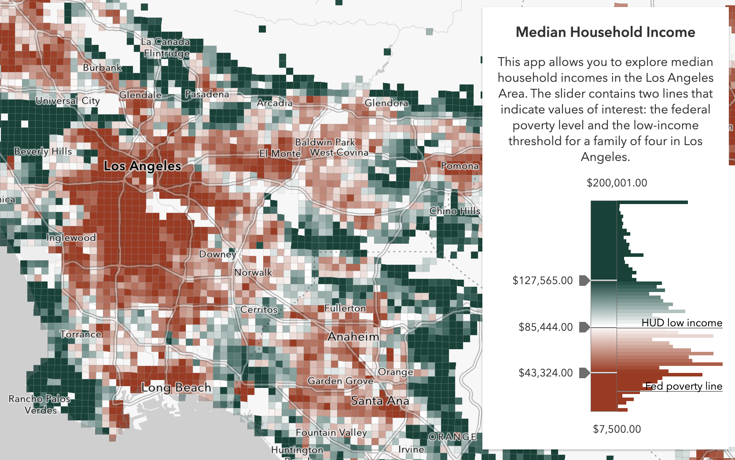
Smart Mapping
It’s all about…
Statistics - Which breaks/stop points make sense?
Color – What colors work best with my basemap? Should it be above and below or high to low?
Class breaks are hard

Slide 18
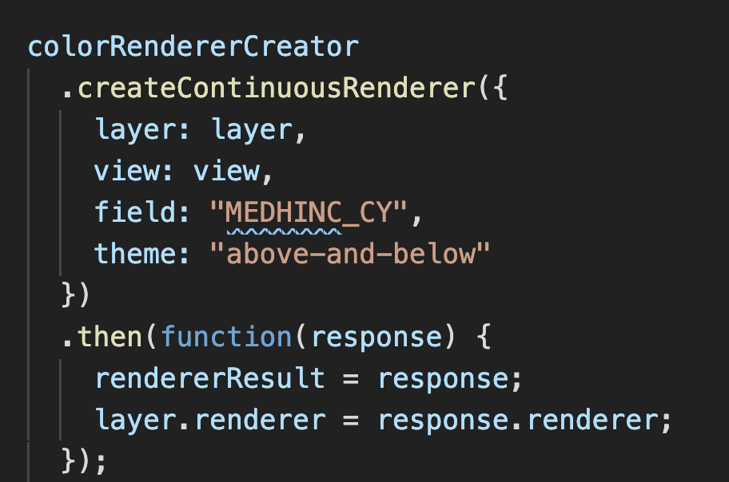
Smart Mapping

Slide 19
Should I always use Smart Mapping? No!
When to use the Smart Mapping APIs
Data exploration
Renderer authoring
Represent unknown statistical data that updates frequently
Statistic queries
When not to use the Smart Mapping APIs
You know your data well
You use standardized colors determined by organization
You can author your style in ArcGIS Online or ArcGIS Enterprise portal
Just because

Slide 20
OK. I shouldn’t use the Smart Mapping APIs... but I still need help with my cartography. What should I do?
You can author your style in ArcGIS Online or ArcGIS Enterprise portal and take advantage of everything Smart Mapping has to offer.
Read the Data Visualization guide pages!
Esri color ramps
Data visualization best practices

Slide 21
Multidimensional Data Exploration

Slide 22
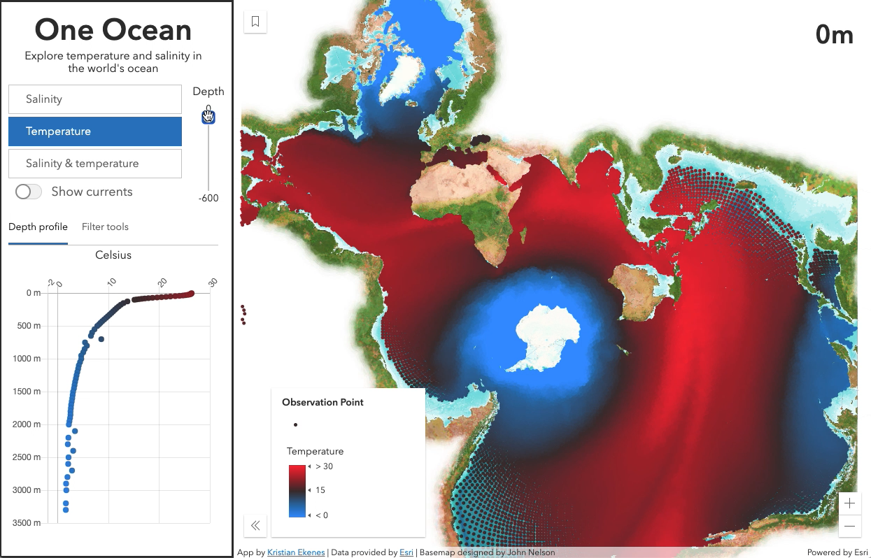
Multidimensional Data Exploration
Different from multivariate viz
Color (e.g. temp)
Size (e.g. speed)
Rotation (e.g. direction)
Opacity
How do the rendered variables vary by some other dimension?
depth
time
cohort (age, income, etc.)

Slide 23

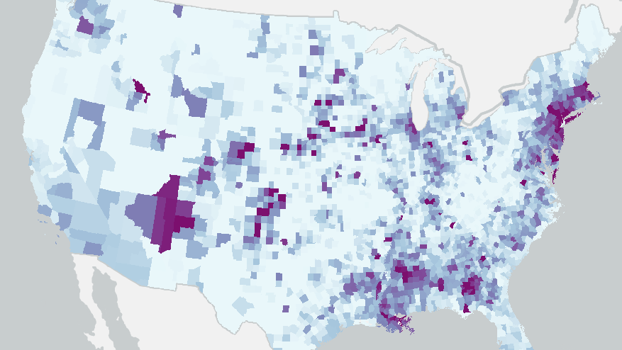
COVID-19
Visualize and explore data from various angles over time

Slide 24
Performance Improvements
Section Subhead

Slide 25
Layer blending
Section Subhead

Slide 26
Resources
Get started with visualization
ArcGIS Blog
Visualization Samples
Documentation
Renderer
Symbol

Slide 27
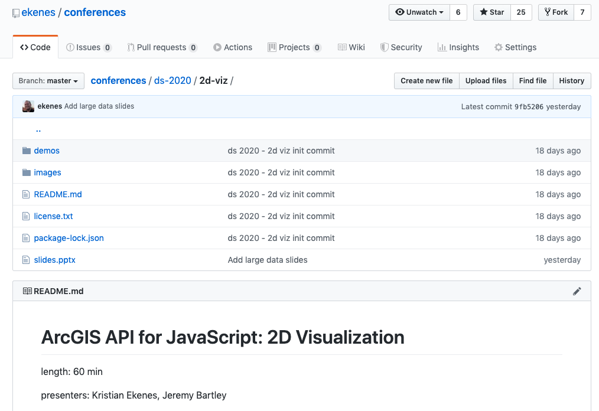
Resources

Slide 28
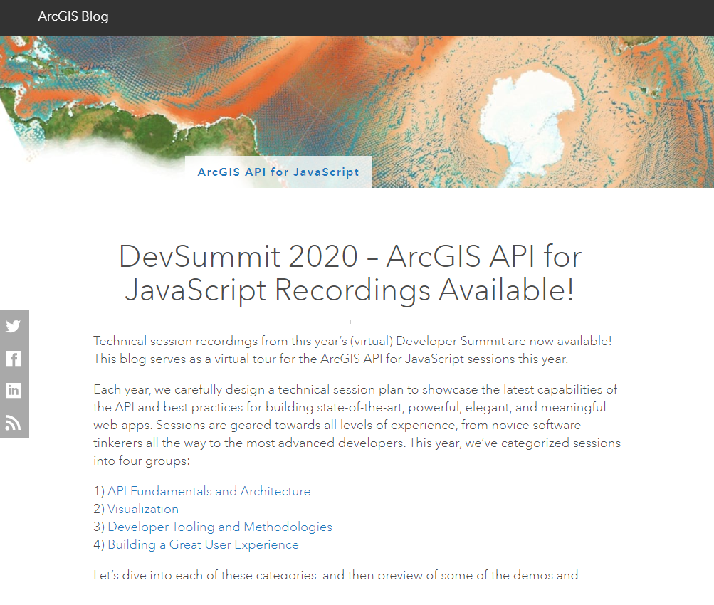

ArcGIS API for JavaScript | 2020 DevSummit Technical Sessions
http://esriurl.com/ds2020jsblog
28 videos focused on developing with the JS API
Recent/relevant content (May 2020)
All tech sessions from 2020 Esri Developer Summit are freely available on YouTube!

Slide 29
Copyright © 2020 Esri. All rights reserved.

